Slide 1


Social media sentiment analysis based on us airline tweets
A Sentiment Analysis Project
Project Supervisor: Dr Amr Rashad Ahmed Abdullatif
Student: Ewere Obiajuru Usifoh-Babalola
UB22048080
This Photo by Unknown Author is licensed under CC BY

Slide 2

Introduction
In the contemporary commercial landscape, the role of feedback in any organisation cannot be overemphasised as this is a critical tool that largely influences the creation and refinement of products and services. It also provides the framework for several decision-making processes for organisations. The recent decade has witnessed exponential growth in social media platforms (AminiMotlagh et al. 2022) like Facebook, X (previously known as Twitter), Snapchat, Instagram, and Tik-Tok amongst others, thereby transforming them into formidable vehicles of public sentiment and opinion. These platforms often serve as means of obtaining feedback directly from end users and observing the ever-changing behaviour of consumers (Ortiz-Ospina and Roser 2023).

Slide 3

Problem Statement
This digital outpouring of feedback often presents itself in massive unstructured data. Attempts to manually analyse such high volumes of data to deduce reliable information could lead to bias and often prove inefficient and labour-intensive. This brings about the challenge faced with handling Big Data.
This Photo by Unknown Author is licensed under CC BY

Slide 4
Aims and Objective
The project aims to investigate social media sentiment analysis by effectively visualising various components of data and building machine learning Algorithms to determine the right data partition and appropriate model for the sentiment classification task of the dataset.
The field of social media sentiment analysis is explored via a dataset based on customer tweets regarding services provided by airlines. The purpose of the project is to build a model that effectively classifies the sentiments associated with customers’ tweets into neutral, negative, and positive, while applying big data analytics tools in visualising the dataset, to explore the reasons behind the customer’s feedback.
Experiments are conducted with various data split ratios to determine the data split ratio that would optimise the efficiency of the chosen ML Algorithms.
The negative tweets in the dataset are about twice as much as the positive and neutral tweets combined. This brings the challenge of an imbalanced dataset, and the Random Minority Oversampling technique is proposed to address this imbalance.
Thereafter, the performance of four different ML Algorithms (Complement Naïve Bayes – CNB, Random Forest -RF, Logistic Regression - LR, and Support Vector Machine – SVM) are evaluated based on the following metrics: Accuracy, Precision, Recall, and F1-score, in order to determine the model that performs better in the polynomial classification task.

Slide 5
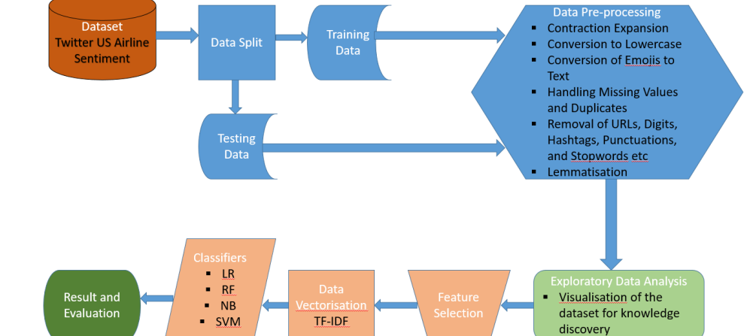
Brief Overview of Methodology
Flow Chart of the Sentiment Analysis Model

Slide 6
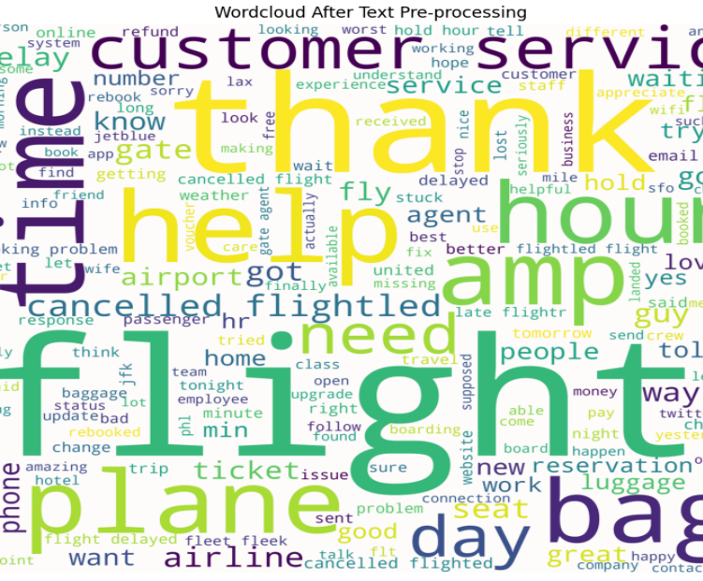
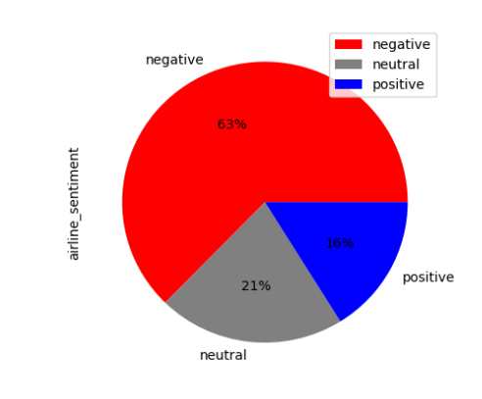
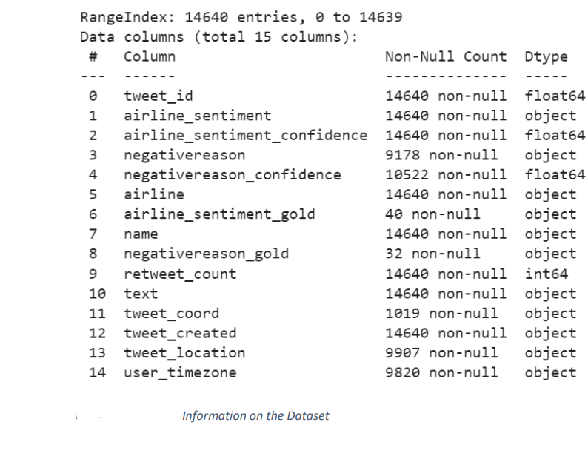
Dataset – Brief Description & Analysis
The Airline Sentiment dataset was obtained from the Kaggle open-source data repository. The tweets posted by the customers on Twitter were classified in three categories: Negative, Neutral, and Positive. The dataset consists of 14,640 instances and 15 features (Figure Eight 2019).

Slide 7
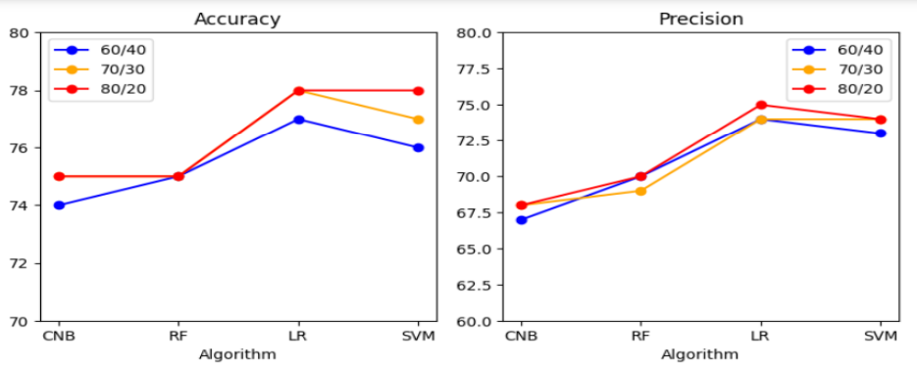
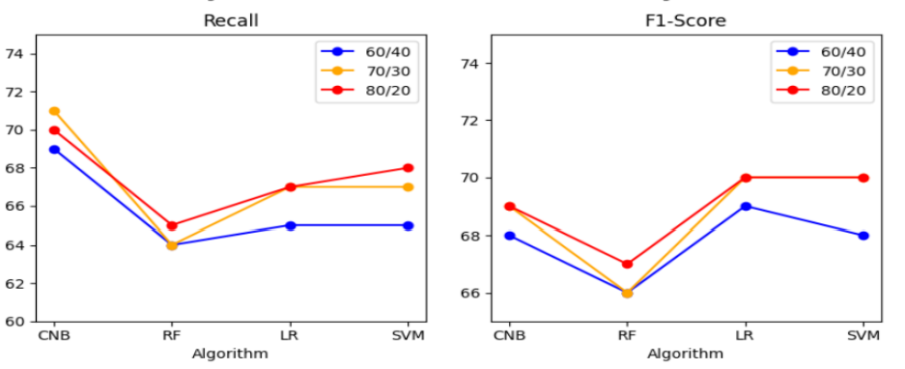
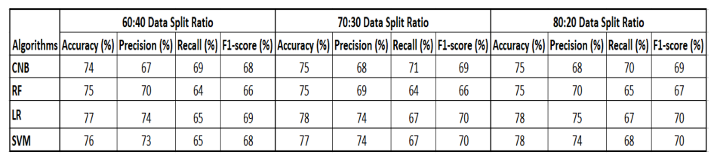
Results
The results reveal that the 80:20 data split ratio achieved better outcomes than the other data split ratios.
However, the Random Forest Classifier exhibited low bias and high variance and the results obtained were not at par with most research literature. Hence Feature Engineering techniques were applied to improve the model performance.

Slide 8
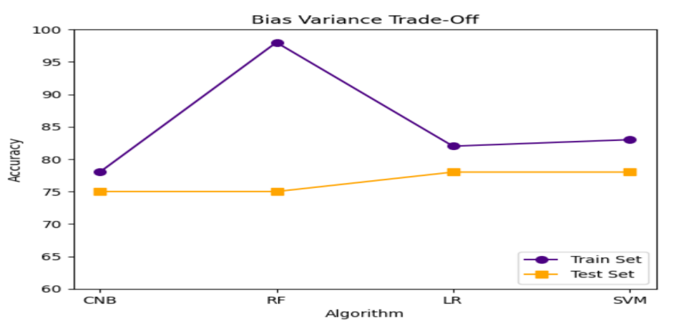
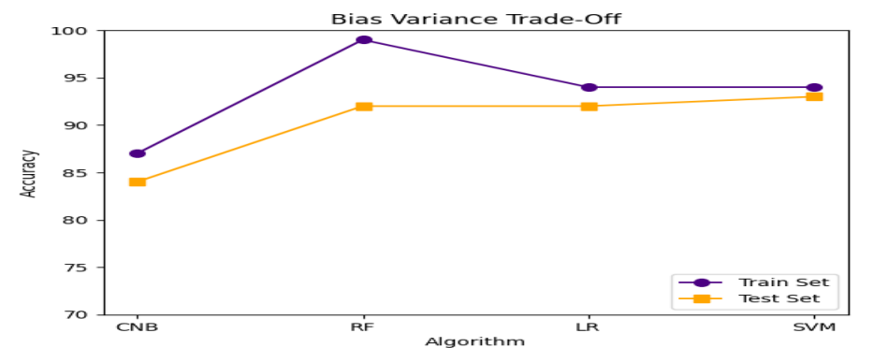
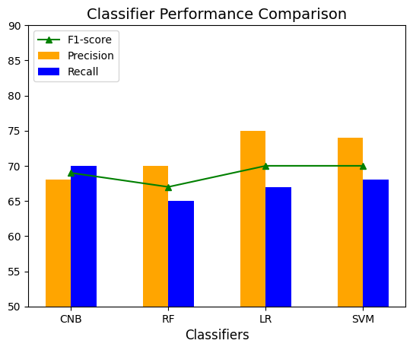
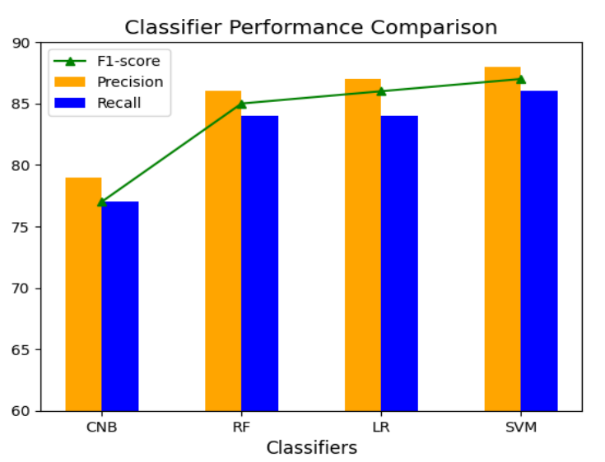
Comparison of Results with the application of Feature Engineering
With Feature Engineering
Without Feature Engineering

Slide 9
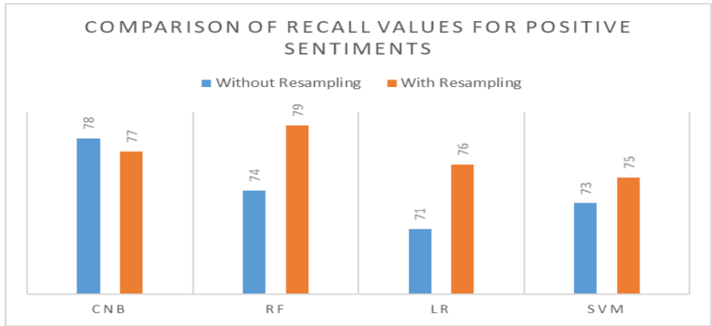
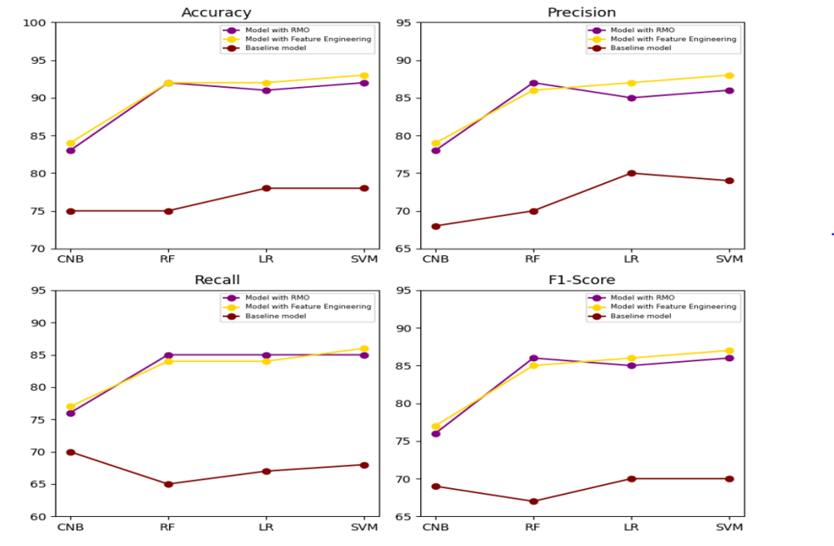
Result Comparison of the Baseline Model, Feature Engineering Model and Model with Resampling
This section displays the results obtained after performing Feature Engineering and Random Minority Oversampling Technique

Slide 10

Conclusion
In this project, a Sentiment Analysis Model was designed using the Twitter US Airline sentiment dataset.
It was analysed for information extraction using data visualisation techniques.
Thereafter, the performance of four different Machine Learning Algorithms were assessed in performing sentiment classification based on different Data split ratios, Feature engineering, and Random Minority Oversampling technique.
It was observed that, the 80:20 data split ratio, in addition to Feature Engineering improved the classification performance of the Algorithms. While the Random Minority Oversampling technique improved the recall score for the Positive sentiments for most Algorithms. The Support Vector Machine classifier attained the highest Accuracy of 93% and F1-score of 87%.
In future, other data mining techniques can be applied to improve the Sentiment Analysis Model.

